Slide 1
Chapter 1 Introduction to Database Systems
Presented by:
Dr. Suvasini Panigrahi
Associate Professor
Dept. of CSE, VSSUT, Burla

Slide 2
Outline
Traditional File Systems
Drawbacks of Traditional File Systems
Database Introduction
Database Applications
An Example
Characteristics of the Database
Database Users
Advantages of using the DBMS approach
Limitations of the DBMS approach

Slide 3
Traditional File Systems
Before the development of database management systems, organization stored information in various files
Each file is independent of each other and is called a flat file
Each user defines and maintains separate files needed for a specific application
Various application programs are used with each file to extract records from, add records to and perform other manipulations on the files
File systems have no centralized control of the data descriptions
Table and field names may be used in different files to mean different things

Slide 4
Example of a Traditional File System
Billing
Program
Purchasing
Program
Customer
file
Accounts
receivable
file
Buyer
file
Inventory
file
Vendor
file
Accounts_Payable
Program
Sales Order Processing
Program
Payroll
Program
Vendor
file
Invoice
file
Customer
file
Inventory
file
Employee
file
Notes:
1

Slide 5
Drawbacks of Traditional File Systems
Data redundancy and inconsistency
Same information may be duplicated in different files. This redundancy leads to high storage and access cost.
Various copies of same data may disagree leading to data inconsistency.
Difficulty in accessing data
Need to write a new program to carry out each new user request for retrieving the required information from the files.
Data isolation
As data are scattered in various files and files may be in different format, writing new application programs to retrieve the appropriate data is difficult.

Slide 6
Drawbacks of Traditional File Systems
Integrity problems
Data stored in the files must satisfy certain integrity constraints. For eg: balance of certain types of accounts should never fall below a certain amount
Developers enforce these constraints by adding appropriate code in the various application programs
Difficult to change the programs each time new constraints are added or existing ones are changed

Slide 7
Drawbacks of Traditional File Systems
Atomicity of updates
Failures in a computer system may leave database in an inconsistent state with partial updates carried out
It is essential for maintaining the database consistency that either a transaction completes or not happen at all.
For eg: In transfer of funds from one account to another, either both credit and debit occur or neither occur
Difficult to ensure atomicity in a conventional file-processing system

Slide 8
Drawbacks of Traditional File Systems
Concurrent Access Anomalies
To improve the overall performance of a system and faster response, many systems allow multiple users to access and update the data simultaneously.
In such a environment, data inconsistency may occur if the concurrent updates are not carried out properly.
Security problems
Not every user of a system should be able to access all the data. Hard to provide user access to some, but not all data.
Database systems offer solutions to all the above problems of traditional file systems

Slide 9
Introduction: Basic Definitions
Data: Known facts that can be recorded and have an implicit meaning.
Database (DB): A collection of related data which is designed, built and populated with data for a specific purpose.
Miniworld/Universe of Discourse (UoD): Some part of the real world about which data is stored in a database.
Database Management System (DBMS): A general-purpose software system which facilitates the process of defining, constructing and manipulating databases for various applications.

Slide 10
Introduction: Basic Definitions
Defining a database involves specifying the data types, structures and constraints for the data to be stored in the database
Constructing the database is the process of storing the data on some storage medium that is controlled by the DBMS
Manipulating the database includes functions such as:
Retrieval: Querying the DB for retrieving certain data and generating reports
Modification: Insertions, deletions and updates to reflect changes in the miniworld

Slide 11
Database Applications
Databases are widely used in almost all aspects of our lives
Traditional Database Applications
Banking: customer information, loans and banking transactions
Credit Card Transactions: purchases on credit cards and generation of monthly statements
Telecommunications: Records of calls made, generating monthly bills, balances on prepaid calling cards, etc.
Airlines: reservations, schedule information
Universities: student information, course registration, grades

Slide 12
Database Applications
Traditional Database Applications
Sales: customers, products, purchases
Manufacturing: production, inventory, orders, supply chain
Human resources: employee records, salaries, tax deductions
Many other applications …
More Recent Applications
YouTube
iTunes
Geographic Information Systems (GIS)
Data Warehouses
Many other applications …

Slide 13
Database System
The DBMS software is a collection of programs that enables users to create and maintain a database
System Catalog/Data dictionary is a collection of data about the database which are used by the DBMS for describing the structure of a database like name of the tables, name of attributes of each table, data types and lengths of attributes, etc.
All this information called metadata (data about data) forms a miniature database
The database and the DBMS software are together called a Database System (DBS)

Slide 14
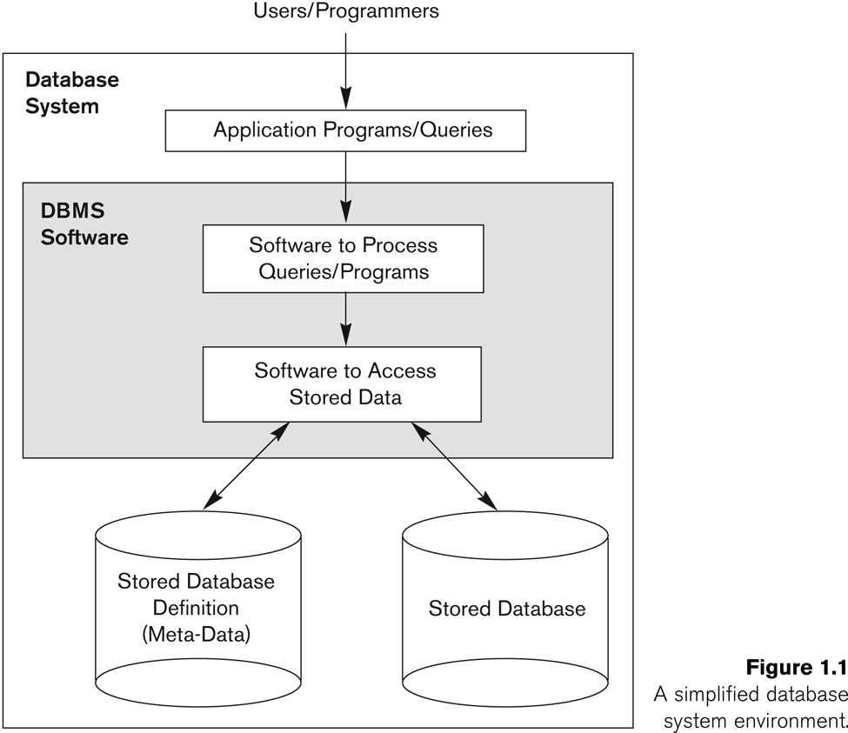
Simplified Database System Environment
In the database approach,
a single repository of data is
maintained which is defined once
and then accessed by various users

Slide 15
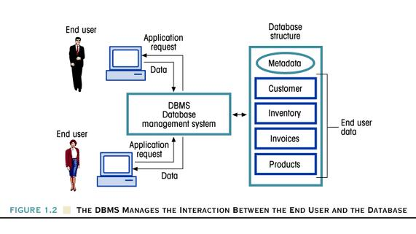
DBMS Manages the Interaction
Between the End User and the Database

Slide 16
Example of a Database System: An UNIVERSITY example
A UNIVERSITY database for maintaining information concerning students, courses and grades in a university environment
We have the following :
STUDENT file stores data on each student
COURSE file stores data on each course
SECTION file stores data on each section of each course
GRADE_REPORT file stores the grades that students receive
PREREQUISITE file stores the prerequisites
To construct the UNIVERSITY database, data is stored to represent each student, course, section, grade report and perquisites as a record in the appropriate table

Slide 17

Example of a simple database
STUDENT
Name | Roll No | Class | Major
Smith | 17 | 1 | CSE
Brown | 8 | 2 | CSE

Slide 18
Databases can be of any size and complexity
Large Library database may contain millions of entries for books issued of different categories
Internal Revenue Service keeps track of the tax forms filled by taxpayers
(if we assume there are100 million taxpayers and each taxpayer files 5 forms with 400 characters of information per form, then we would get a database of size 800 giga bytes)
Amazon.com
(15 million people visit per day; about 100 people are responsible for database update)

Slide 19
Characteristic of the Database Approach
The main characteristic of the database approach versus the file processing approach are the following:
Self-describing nature of a DB
Insulation between programs and data and data abstraction
Support of multiple views of the data
Sharing of data and multiuser transaction processing

Slide 20
Self-describing nature of a database system
Database system contains not only the database itself but also a complete definition of the database structure and constraints
The information stored in the system catalog is called Meta-data (data about data), and it describes the structure of the database

Slide 21
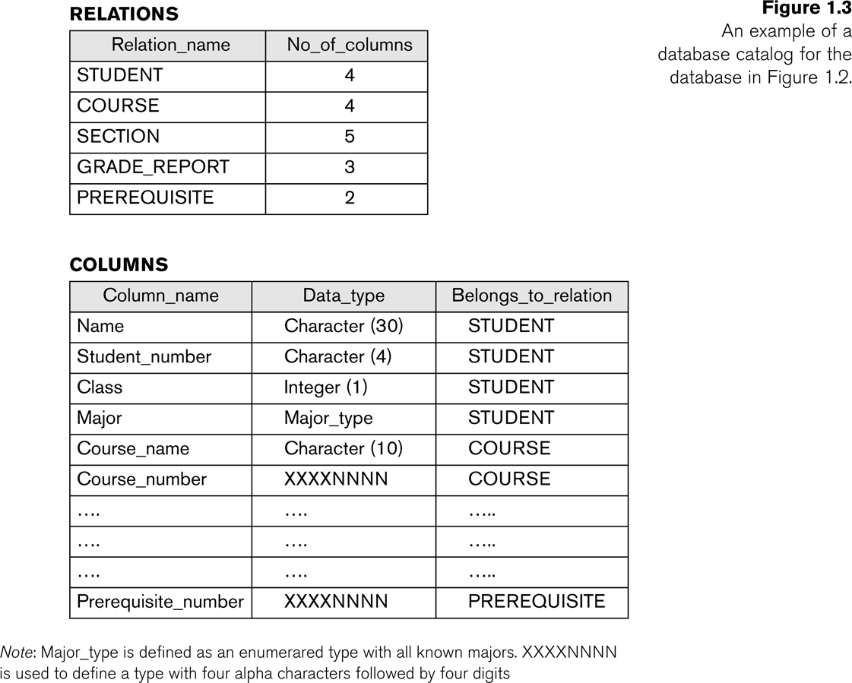
Example of a simplified Meta-data

Slide 22
Insulation between programs and data and data abstraction
In file processing, if any changes to the structure of a file may require changing all programs that access the file
In database system, the structure of data files is stored in the DBMS catalog separately from the access programs
Allows changing data storage structures and operations without having to change the DBMS access programs
This is called program-data independence

Slide 23
Insulation between programs and data and data abstraction
Data Abstraction: DBMS provides a conceptual view of the database to the users that does not include the storage details of data and how the operations are implemented in the database
A data model is a type of data abstraction that is used to provide this conceptual representation

Slide 24
Support of multiple views of the data
Each user may see a different view of the database, which describes only the data of interest to that user
It may also contain some virtual data that is derived from the database files but its not explicitly stored

Slide 25
Sharing of data and multi-user transaction processing
Allowing a set of concurrent users to retrieve from and to update the database.
Concurrency control within the DBMS guarantees that each transaction is correctly executed or aborted
For example, when several reservation clerks try to assign a seat on an airplane flight
These types of applications are generally called online transaction processing (OLTP)

Slide 26
Database Users
Many persons are involved in the design, use and maintenance of a large database with few hundred users
Database users may be divided into the following groups:
Persons whose jobs involve the day-to-day use of a large database are called “Actors on the Scene” (control the content of the database)
Users who are associated with the development of the database and the design and implementation of the DBMS software are called “Workers Behind the Scene”

Slide 27
Database Users: Actors on the Scene
Database Administrators (DBAs):
In any organization when many persons use the same resource, there is a need for a chief administrator to manage these resources
In a database environment, the primary resource is the database itself and the secondary resource is the DBMS software.
Administering these resources is the responsibility of the DBA.
DBA is responsible for authorizing access to the database, for coordinating and monitoring its use, acquiring software and hardware resources, controlling its use and monitoring efficiency of operations.

Slide 28
Database Users: Actors on the Scene
Database Designers:
Responsible for identifying the data to be stored in the database and for choosing the appropriate structure to represent and store the data.
They must communicate with different database users, understand their requirements and come up with the design that meets the requirements of all users.
These tasks are mostly undertaken before the database is actually implemented and populated with data.
End Users:
These are the people whose jobs require access to the database for querying, updating and generating
Database primarily exists for these users

Slide 29
Database Users: Actors on the Scene
Categories of End-users
Casual: Access database occasionally but may need different information each time. Eg. manager
Naive/Parametric: These users make up a large section of the end-user population and are constantly involved in querying and updating the database. Eg. Reservation clerks
Sophisticated: These include business analysts, scientists, engineers and others who are thoroughly familiar with the facilities of the DBMS so as to implement their applications to meet their requirements
Stand-alone: Mostly maintain personal databases using ready-made packages that provide menu or graphical interfaces.
Eg. User of a tax package that stores a variety of personal financial data for tax purpose.

Slide 30
Database Users: Actors on the Scene
System Analysts and Application Programmers (Software Engineers)
System analysts determine the requirements of end-users (naive) and develop specifications for transactions that meet these requirements
Application programmers implement these specifications as programs, then they test, debug, document and maintain these transactions

Slide 31
Other DBS Users: Workers Behind the Scene
DBMS System Designers and Implementers
Persons who design and implement the DBMS modules and interfaces as a s/w package
Tool Developers
Persons who design and implement tools (optional packages for performance monitoring, simulation, test data generation, etc.)
Operators and maintenance personnel
Responsible for actual running and maintenance of the h/w and s/w environment for the DBS

Slide 32
Advantages of using the DBMS approach: Controlling Redundancy and Maintaining Data Consistency
In the traditional file approach, every user group maintains its own files for handling various data processing applications.
For example: accounting office keeps data on registration and billing information, whereas the registration office keeps track of registration, student courses and grades
Much of the data are stored twice: once in the files of each user group.

Slide 33
Controlling Redundancy and Maintaining Data Consistency
This redundancy in storing the same data multiple times leads to several problems:
We need to update data several times (duplication of effort)
Storage space is wasted
Files that represent the same data may become inconsistent as any update may be applied to some files and not to others

Slide 34
Controlling Redundancy and Maintaining Data Consistency
In DBMS, the data redundancy can be controlled or reduced but is not removed completely
Sometimes, it is necessary to create duplicate copies of the same data items in order to relate tables with each other (controlled redundancy)
By controlling the data redundancy, we can save storage space and avoid data inconsistency

Slide 35
Advantages of using the DBMS approach: Restricting Unauthorized Access (Data Security)
Data security is the protection of the database from unauthorized users
Only the authorized persons are allowed to access the database
The database access is controlled by the DBA. Mostly, the DBA can access all the data in the database. Some users may be permitted only to retrieve data, whereas others are allowed to retrieve as well as to update data.
Most of the DBMSs provide the security and authorization subsystem, which the DBA uses to create accounts of users protected by passwords and to specify account restrictions

Slide 36
Advantages of using the DBMS approach: Enforcing Integrity Constraints
Integrity constraints or consistency rules are applied to a database so that the correct data is entered into the database
Examples of integrity constraints are:
Maximum obtained marks in a subject cannot exceed 100
'Issue Date' in a library system cannot be later than the corresponding 'Return Date' of a book
There are also some standard constraints that are intrinsic in most of the DBMSs. Eg.: NOT NULL, PRIMARY KEY, etc.
DBA identifies the integrity constraints during database design
The integrity constraints are automatically checked at the time of data entry or when a record is updated.

Slide 37
Other Advantages of using the DBMS approach:
Data Sharing:
DBMS allows the sharing of data under its control by any number of application programs or users
Many users can be authorized by the DBA to access the same piece of information simultaneously
Concurrency control schemes are used in a database to coordinate simultaneous transactions while preserving data integrity. It addresses conflicts with the simultaneous accessing or altering of data that can occur in a multi-user system

Slide 38
Other Advantages of using the DBMS approach
Integration of Data and Representing complex relationships among data
In database approach, a single repository of data is maintained which is defined once and then accessed by various users
A database contains data stored in multiple tables and a DBMS has the capability to represent a variety of complex relationships among the data which makes the access and updating of data easier

Slide 39
Other Advantages of using the DBMS approach:
Providing Backup and Recovery (Data Atomicity)
A DBMS provides facilities for recovering from hardware or software failures
The backup and recovery subsystem of the DBMS is responsible for recovery
For eg. if the computer system fails in the middle of a complex update program, the recovery subsystem is responsible for making sure that the database is restored to the state it was in before the program started executing

Slide 40
When NOT to use DBMS?
In spite of the advantages of using a DBMS, there are few situations in which it may involve unnecessary overhead costs which would not be there in traditional file processing systems.
The overhead costs could be due to the following:
High initial investment in hardware, software and training
The cost of defining and processing data
Overhead for providing security, concurrency control, recovery and integrity functions

Slide 41
When NOT to use DBMS?
Hence, it may be more desirable to use regular files under the following situations:
Simple, well-defined database and applications that are not expected to change
Real-time requirements for some programs that may not be met due to DBMS overheads
Multiple-user access to data is not required

